Slide 1

Department Of Information Technology ABES Engineering College, Ghaziabad
CREDIT CARD FRAUD DETECTION SYSTEM
SESSION 2023-24
Name- Humayun Khalid
Class & Section- IT A
Roll no- 2100320139005
Admission no. -2021B0133004

Slide 2
CONTENTS:-
ABOUT THE PROJECT
OBJECTIVES OF THE PROJECT
PROJECT BASED LEARNING UNDER THE COURSE
CHALLENGES AND LIMITATIONS
CONCLUSION
ANNEXURES: A. Code Snippets
B. Project demo snippets
C. Certification

Slide 3
What is actually credit card fraud detection System?
A credit card fraud detection system is a critical component of financial institutions and online payment processors' efforts to protect their customers from fraudulent activities. One approach to building such a system is to use machine learning techniques like logistic regression.
Credit card fraud detection is a set of methods and techniques designed to block fraudulent purchases, both online and in-store. This is done by ensuring that you are dealing with the right cardholder and that the purchase is legitimate.
Address Verification Service (AVS) is one of the most widely used fraud prevention tools in card-not-present (CNP) transactions. An AVS check compares the billing address used in the transaction with the issuing bank's address information for the cardholder.

Slide 4
Machine Learning Models
Logistic regression: Logistic regression is a simple but effective model for binary classification tasks, such as predicting whether a transaction is fraudulent or not.
Decision trees: Decision trees are a type of tree-based model that learns to classify data by splitting it into smaller and smaller subsets based on the values of different features.
Random forests: Random forests are an ensemble model that combines the predictions of multiple decision trees to produce a more accurate prediction.
Gradient boosting machines (GBMs): GBMs are another type of ensemble model that combines the predictions of multiple weak learners to produce a more accurate prediction.
Support vector machines (SVMs): SVMs are a type of model that learns to classify data by finding a hyperplane that separates the data into two classes with the largest possible margin.
Neural networks: Neural networks are a type of machine learning model that is inspired by the structure and function of the human brain. Neural networks can be used to learn complex patterns in data and can be very effective for credit card fraud detection.

Slide 5
Project Based learning under the Course
How to use linear regression to model binary classification problems. Linear regression is a common algorithm for modeling continuous variables, but it can also be used to model binary classification problems by using a logistic transformation. This course would teach me how to prepare data for linear regression, train a linear regression model, and interpret the results.
How to evaluate the performance of a fraud detection system. It is important to evaluate the performance of a fraud detection system to ensure that it is effective and does not generate too many false positives. This course would teach me how to use metrics such as accuracy, precision, recall, and F1 score to evaluate the performance of a fraud detection system.
How to deal with class imbalance in fraud detection datasets. Fraud detection datasets are often imbalanced, meaning that there are many more legitimate transactions than fraudulent transactions. This can make it difficult for machine learning algorithms to learn to detect fraudulent transactions. This course would teach me how to deal with class imbalance in fraud detection datasets using techniques such as oversampling and undersampling.
How to deploy a fraud detection system in production. Once a fraud detection system has been trained and evaluated, it needs to be deployed in production so that it can be used to detect fraudulent transactions in real time. This course would teach me how to deploy a fraud detection system in production using tools and technologies such as Docker and Kubernetes.

Slide 6
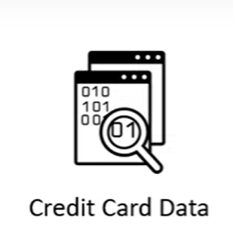
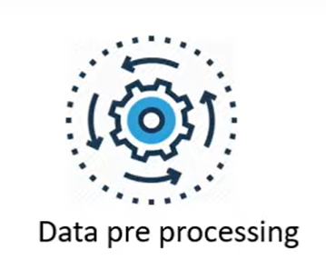
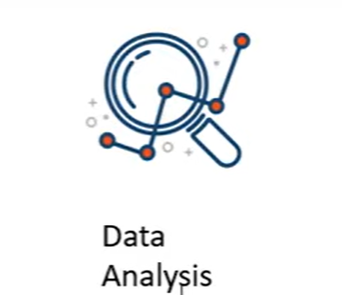

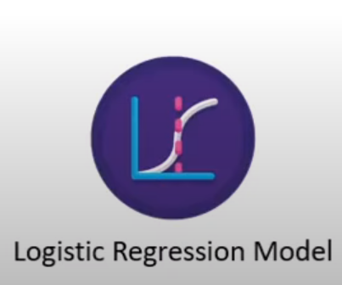
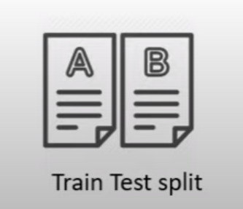
WORK FLOW

Slide 7
Challenges and Limitations
Linearity assumption: Logistic regression assumes that the relationship between the independent variables (features) and the dependent variable (fraudulent or not) is linear. This assumption may not be true for all credit card fraud datasets.
Overfitting: Logistic regression is prone to overfitting, which means that it can learn the training data too well and not generalize well to new data.
Imbalanced data: Credit card fraud data is often imbalanced, with many more non-fraudulent transactions than fraudulent transactions. This can make it difficult for logistic regression models to learn to identify fraudulent transactions.
Concept drift: Concept drift occurs when the distribution of the data changes over time. This can happen in credit card fraud detection, as fraudsters develop new techniques to avoid detection. Logistic regression models may not be able to adapt to concept drift as well as other machine learning models, such as neural networks.

Slide 8
Conclusion
In conclusion, the logistic regression model is a simple but effective model for credit card fraud detection. It is easy to implement and interpret, and it can achieve good performance on a variety of datasets. However, it is important to be aware of the challenges and limitations of logistic regression, such as the linearity assumption, overfitting, imbalanced data, and concept drift.
Here are some specific conclusions that can be drawn from the logistic regression model of a credit card fraud detection system:
The model can identify the most important features that contribute to credit card fraud.
The model can be used to predict the probability of fraud for each transaction.
The model can be used to develop rules and alerts to identify and flag suspicious transactions.
The logistic regression model can be a valuable tool for credit card fraud detection, but it is important to use it in conjunction with other fraud detection measures, such as risk-based authentication and fraud monitoring.
Overall, the logistic regression model is a good choice for credit card fraud detection, especially if the dataset is small or if the features are not highly correlated.

Slide 9
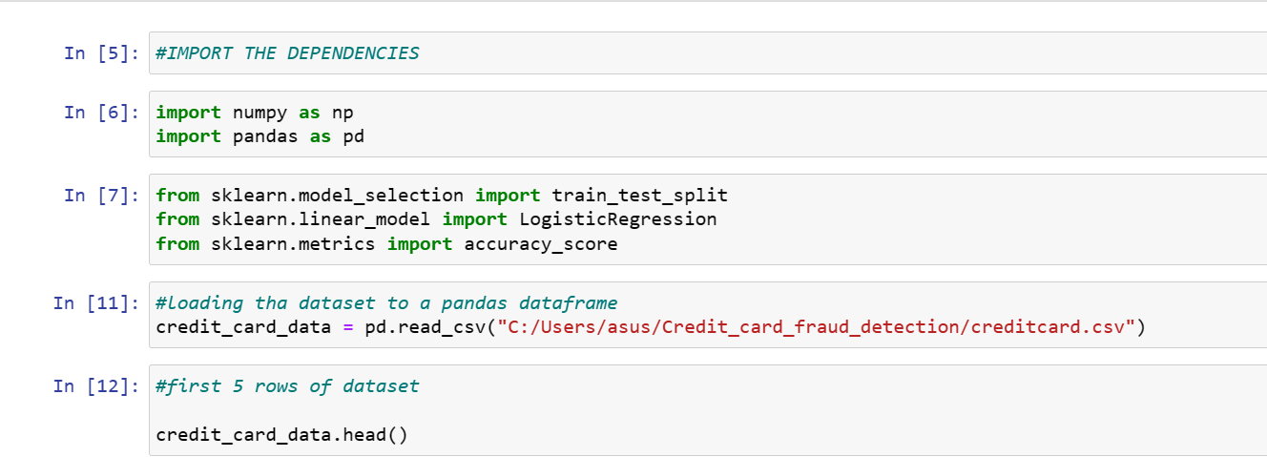
CODE SNIPPETS

Slide 10
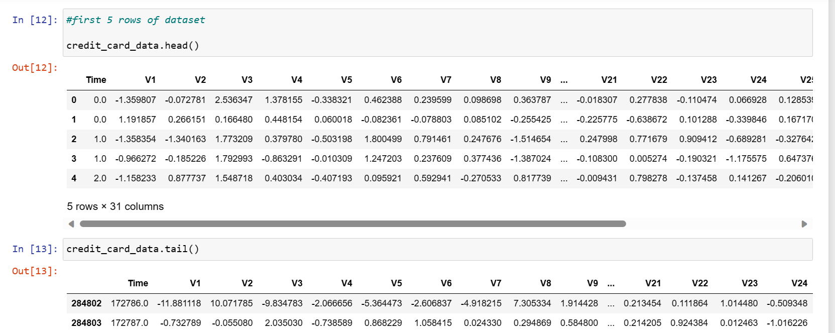

Slide 11
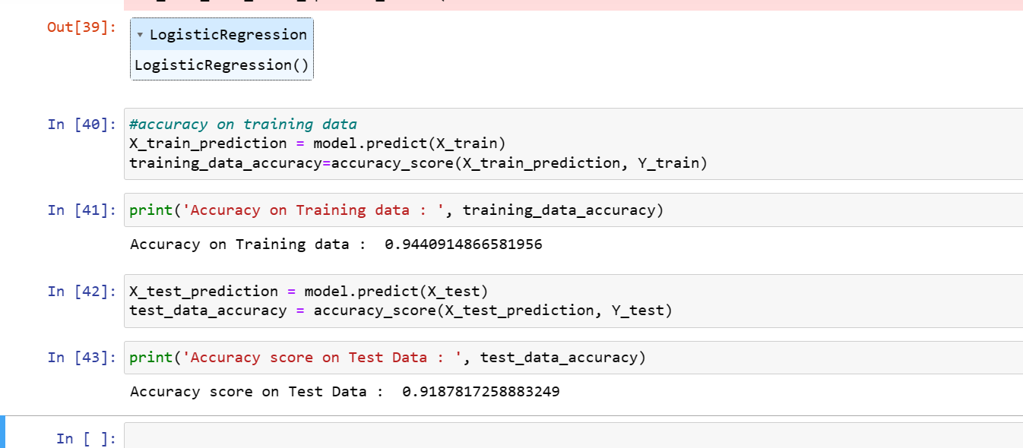

Slide 12

Certification

Slide 13
THANK YOU!

